Slide 1
UniBuddy
Gen AI Powered Personal Assistant

Slide 2
Team Members
Deepak Ayyasamy
Tarun Siga
Sai Karthik Naladala
Main Repository: https://github.com/TarunSiga/DSCapstoneProject

Slide 3
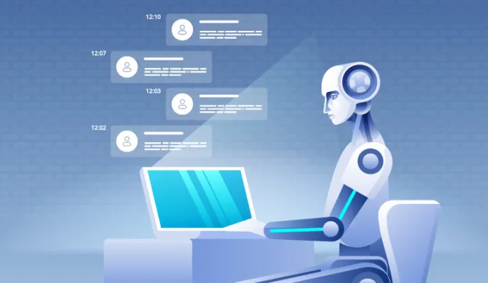
Abstract
UniBuddy: a revolutionary virtual assistant tailored for students.
Combines natural language processing, real-time data management, and user-centric design principles.
Empowers students with seamless access to university-related information, fostering informed decision-making and personalized engagemen

Slide 4

Introduction
UniBuddy is a sophisticated virtual assistant designed to enhance the university experience for students.
Provide students with comprehensive access to information about universities, academic programs, and extracurricular activities.
Leveraging advanced technologies and user-centric design principles to create an intuitive and responsive platform for navigating the complexities of university life.

Slide 5

Offering Overview
UniBuddy is an AI personal assistant services tailored specifically for students in the US.
This service encompasses a comprehensive approach to academic support, including study skills, time management, and emotional assistance.
UniBuddy aims to bridge the gap between students and academic success by providing holistic guidance and personalized assistance to navigate through their educational journey effectively.

Slide 6

Team Contribution
Deepak Ayyasamy: Machine Learning Development
Ingestion Module Development
Local GPT Module Development
Code Refinement and Documentation
GitHub: https://github.com/TarunSiga/DSCapstoneProject/tree/DeepakAyyasamy

Slide 7

Team Contribution
Tarun Siga: Front End Development
User Profile Management
Worked on collecting the catalogues, processing the data, and created embeddings.
Improved chat experience
Scalability and performance optimization
Streamlined export options
Responsive Design
Worked on the evaluation of different kinds of large language models (GPT 3.5, Gemini, and Perplexity) and compared with UniBuddy
GitHub: https://github.com/TarunSiga/DSCapstoneProject/tree/TarunSiga

Slide 8

Team Contribution
Sai Karthik Naladala: Back End Development
Integrates Firebase authentication for user registration and login.
Integrates Firebase authentication for user registration and login.
Provides functionality to switch between the login and registration forms.
Integrates Firebase Firestore for storing chat history.
Implements speech recognition using the SpeechRecognition library for voice input.
Displays chat history and handles user input with appropriate responses.
Done working on integrating functionality to send prompts to a fine-tuned model and retrieve responses. Additionally, add a logout functionality to the Unibuddy Home page where the user will be redirected to the login page after clicking on it.
GitHub: https://github.com/TarunSiga/DSCapstoneProject/tree/saikarthiknaladala

Slide 9
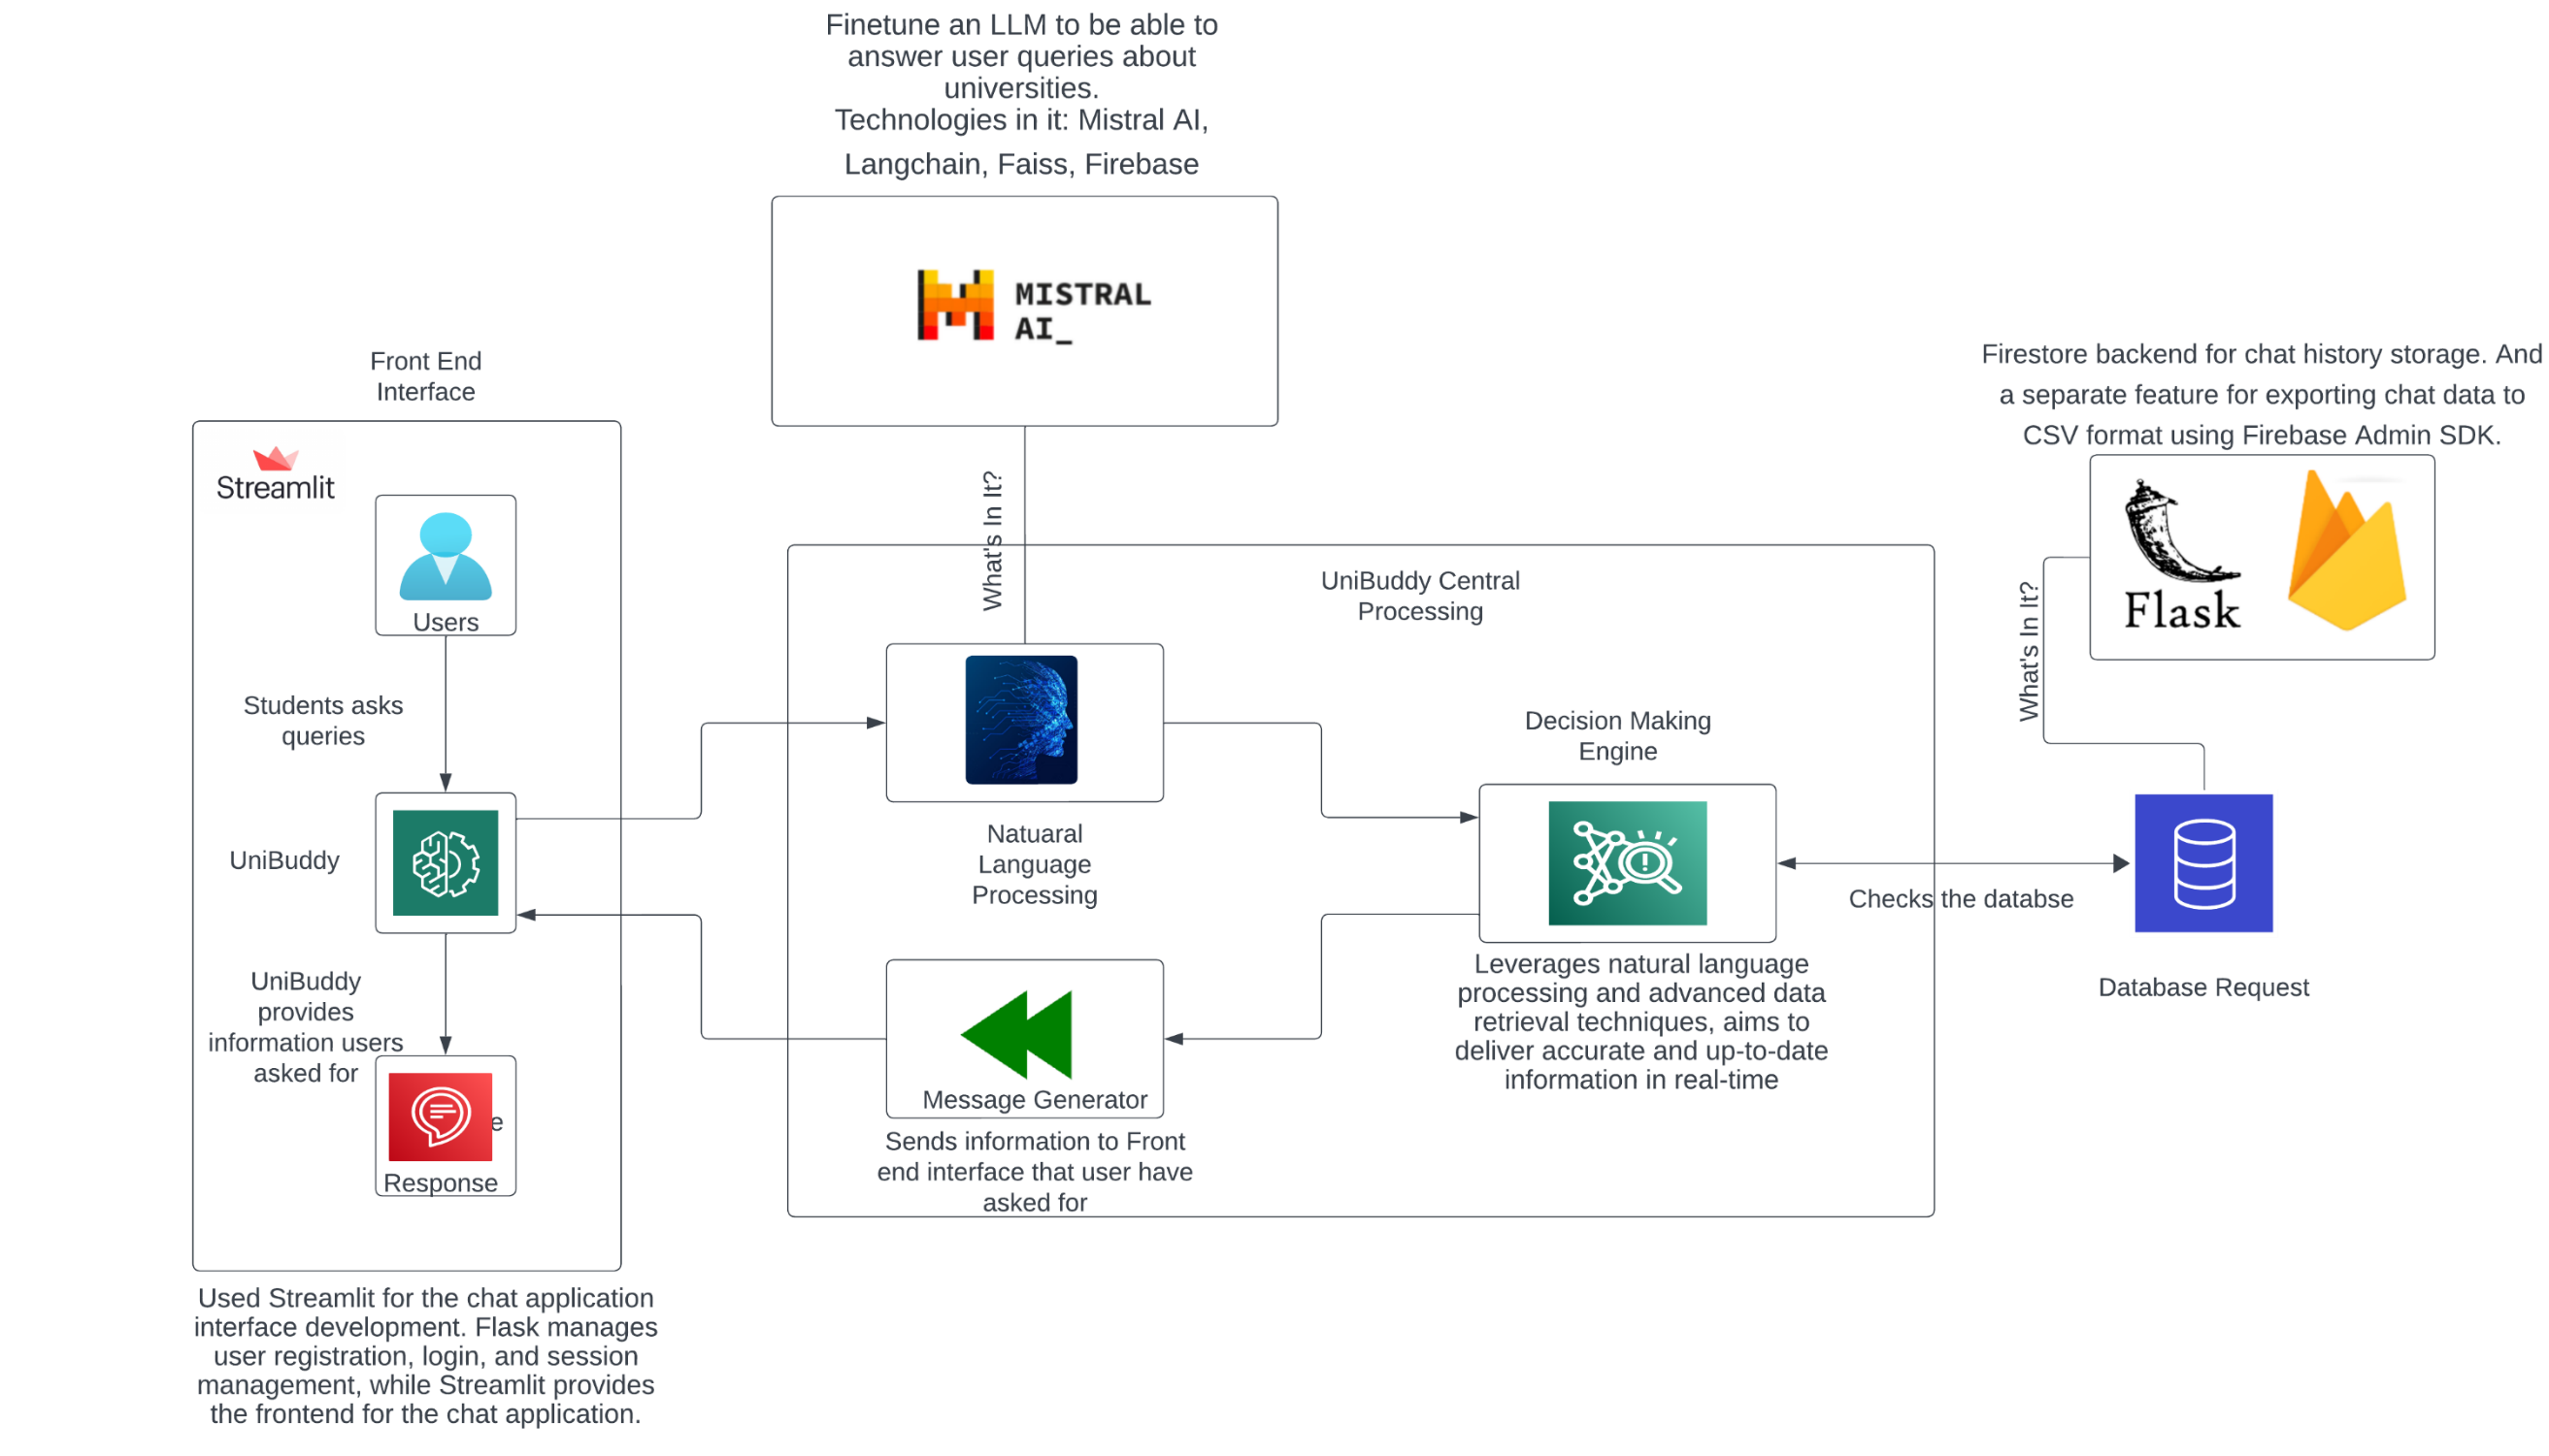
Concept Diagram

Slide 10
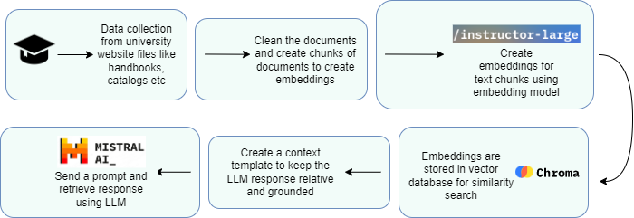
Model Diagram

Slide 11
Methodology
1. User Authentication and Registration
3. Creating Embeddings
5. Results & Evaluation
2. Data Collection and Preprocessing
4. LLM Fine-tuning

Slide 12

Methodology
User Authentication and Registration System:
The foundation of UniBuddy's security and user management lies in the implementation of a robust authentication and registration system.
Utilizing Flask, a lightweight web framework, in conjunction with Firebase Authentication services, ensures secure user authentication through various methods such as email/password, phone number, or social media logins.
This system guarantees data privacy and integrity while providing users with a seamless and hassle-free registration process.

Slide 13
Methodology
Embeddings:
• Text embeddings play a crucial role in UniBuddy's natural language processing capabilities, enabling efficient text representation and similarity search.
• By creating embeddings from text chunks using instructor-large LLM embedding model, UniBuddy enhances the accuracy and relevance of its responses to user queries.
• These embeddings are stored in a vector database, facilitating fast and efficient retrieval of information based on user preferences and requirements.
• Chrome DB is used as a vector database to store all the embedding vectors.

Slide 14
Methodology
LLM Fine-tuning:
• Once the embeddings are created, the base LLM receives the user query and it is supposed to send a response to that query.
• User query text is converted into embeddings using the same embedding model used for converting input file and the question vector is compared with all the generated vectors in the vector database, i.e. Chroma DB.
• Once a similar vector is identified, LLM retrieves the vector, decodes it into text and refines it to make it look like human generated response.
• Thus, the generated response is given as an output to the user.

Slide 15
Methodology
Ingestion Module Development:
• An efficient document loading module is developed to facilitate seamless ingestion and processing of data within the UniBuddy ecosystem.
• Utilizing multithreading and multiprocessing techniques, along with robust error handling mechanisms and logging systems, ensures the smooth operation of the ingestion module. This module enables UniBuddy to efficiently process large volumes of data, providing users with timely and relevant information.

Slide 16
Methodology
Local GPT Module Development:
• UniBuddy's local GPT module is specifically designed for retrieval question-answer tasks, leveraging advanced techniques to optimize performance and resource utilization.
• Integrating embeddings and vector stores enhances the efficiency of text representation and retrieval, enabling UniBuddy to deliver accurate and timely responses to user queries.
•By optimizing performance and resource utilization, the local GPT module ensures a seamless and responsive user experience within the UniBuddy platform.

Slide 17
Data Cleaning & Preprocessing
Relevant pdf files are downloaded and index files, synopsis etc are removed to prevent irrelevant information feeding into embedding model.
Convert documents into chunks to make sure text content can fit into LLM prompt for LLM fine-tuning.
PDF is read using a package called ‘PyPDF2’ to clean content and rewritten post cleaning.

Slide 18
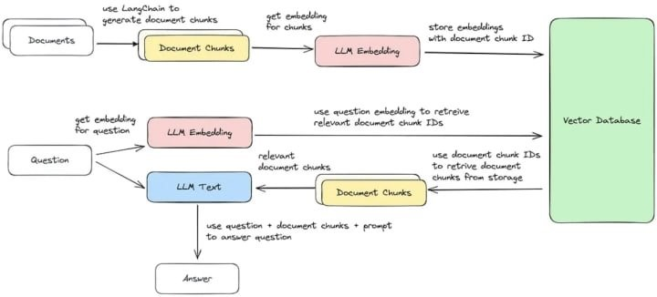
Creating embeddings
Create embeddings from text chunks using appropriate embeddings models.
“instructor-large” is used here based on its rating on embeddings of large files.
Created embeddings are stored in a vector database for similarity search. Chroma DB is used for storing created embeddings.

Slide 19
LLM fine-tuning
Design retrieval prompt template to extract relevant responses from the LLM.
Once the user sends a query, the variables are fit in the prompt template and sent for inference.

Slide 20
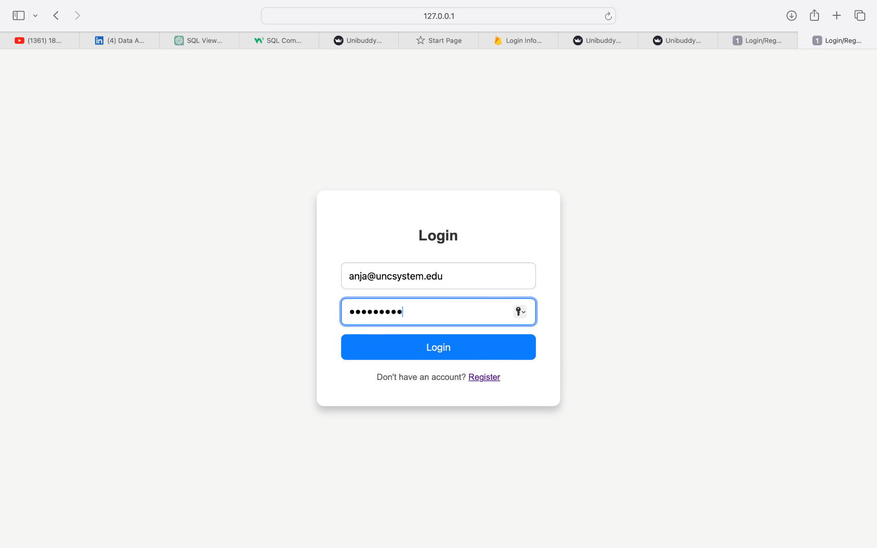
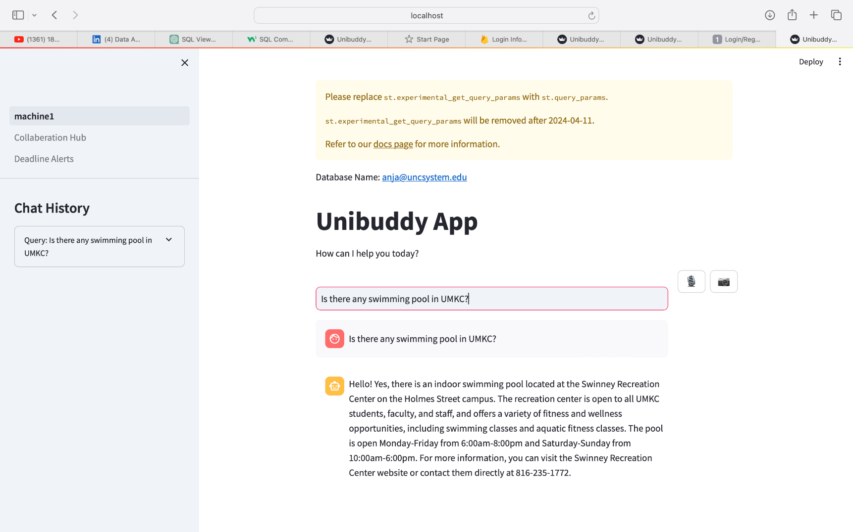
Results

Slide 21
Evaluation
To evaluate the performance of our fine-tuned LLM module, we compared the results of our LLM model with the top Gen AI application in the market, like, GPT 3.5, Gemini 1.5 and Perplexity AI.
We calculated this for 25 different questions and then arrived at mean values. Results suggested Unibuddy outperformed GPT 3.5 and Perplexity AI and came second to Gemini only by a bit.
Aspect | UniBuddy | GPT 3.5 | Gemini | Perplexity
Reality | 10 | 10 | 10 | 6
Comprehensiveness | 8 | 8 | 10 | 4
Clarity | 10 | 8 | 10 | 6
Helpfulness | 8 | 8 | 10 | 4
Overall Score | 9 | 8.5 | 10 | 5

Slide 22

Future improvements
Design personalization using user-specific information gathering.
Implement real-time RAG fine-tuning by updating data chunks and keeping up the vector database.
Build new features into product like customized recommendations.

Slide 23

Challenges
Data Collection: Faced difficulties in finding domain specific data that is latest and has enough information
Resource intensive functionalities: File ingestion to create embeddings required high end processor to withstand the resource intensive task of fine-tuning with domain data and to perform in a efficient manner.
Lack of community: Since LLMs burst out into the scene, the community is still growing and building anything including a niche idea takes time and effort to tie all loose ends.

Slide 24

Conclusion
UniBuddy project represents a significant milestone in the realm of virtual assistant technology, offering a comprehensive and user-centric solution for navigating the complexities of university life. Through meticulous implementation of advanced technologies such as natural language processing, real-time data management, and user authentication systems, UniBuddy has successfully revolutionized the way students interact with university-related information.

Slide 25
Thank you!

